Slide 1

PHP Loops
Umer Shahzad

Slide 2
Loops are used in PHP to execute a block of code repeatedly for a specified number of times or until a certain condition is met. This allows us to perform repetitive tasks, such as iterating over arrays or database records, without having to write the same code multiple times. Loops are also useful for tasks such as processing large amounts of data, generating dynamic content, and creating dynamic forms.
Umer Shahzad

Slide 3
Types of Loops in PHP:
There are 4 Types of Loops in PHP
1: While Loop
2: Do While
3: For Loop
4: foreach (used for arrays)

Slide 4

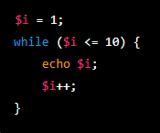
Syntax of While Loop:

Slide 5

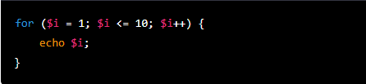
Syntax of forloop:

Slide 6

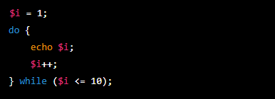
Syntax of Do-While Loop:

Slide 7

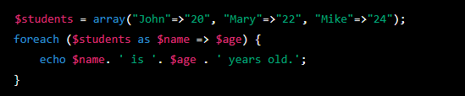
Syntax of foreach Loop:
The foreach loop is very useful for iterating over arrays and objects, it makes the code more readable and easy to understand.

Slide 8
Thank You! For Giving Your Important Time.

